Slide 1
Microsoft Azure Training
1.2 Infrastructure Services

Slide 2
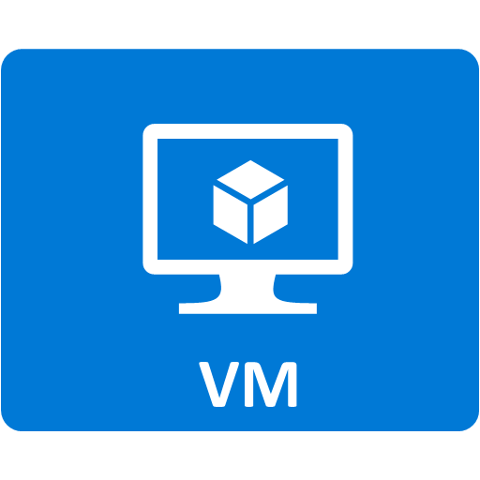
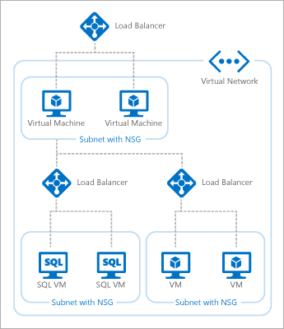


1. Microsoft Azure Infrastructure Services
Build a multi-tier, resilient, secure application that can deploy in minutes.
Virtual Machine
Virtual Network
Storage

Slide 3





2. Virtual Machine
Software version of a computer that you configure and maintain according to your needs.
Customized Windows and Linux VMs with complete control of the OS
An operating system image is a set of one or more files to be used as a template to create a new virtual machine. An image acts like a template because it doesn’t have the personalized settings that a configured virtual machine has, such as the computer name and user account settings.
A virtual machine OS disk is virtual hard disk (in .vhd file format) that can be booted and mounted as a running version of an operating system instance. Virtual machines can also use one or more data disks, which can be attached to the virtual machine at any time.
An Microsoft Azure application can have multiple virtual machines. All virtual machines that you create in Microsoft Azure can automatically communicate using a private network channel with other virtual machines in the same cloud service or virtual network. Microsoft Azure allows you to load-balance traffic between them.
Microsoft Azure
Cloud Service
DNS Name
Endpoint
Virtual Machine
OS Disk
Data Disk
Host Name
Azure Storage
Storage account

Slide 4






Get Start with Azure Virtual Machines
2. Virtual Machine
Azure provides you easy way to manage VMs.
Start Easy
Image Gallery
Durable Storage
Management Portal
>_
Virtual Machine Instance
Scripting
(Windows, Linux and Mac)
VHD
VHD
VHD
REST API

Slide 5
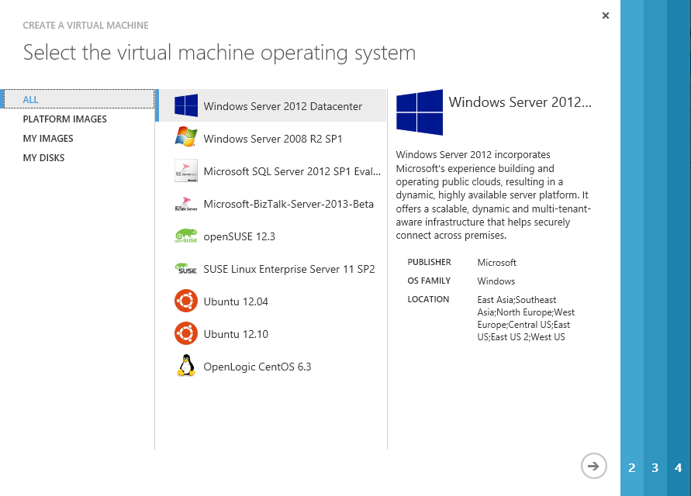
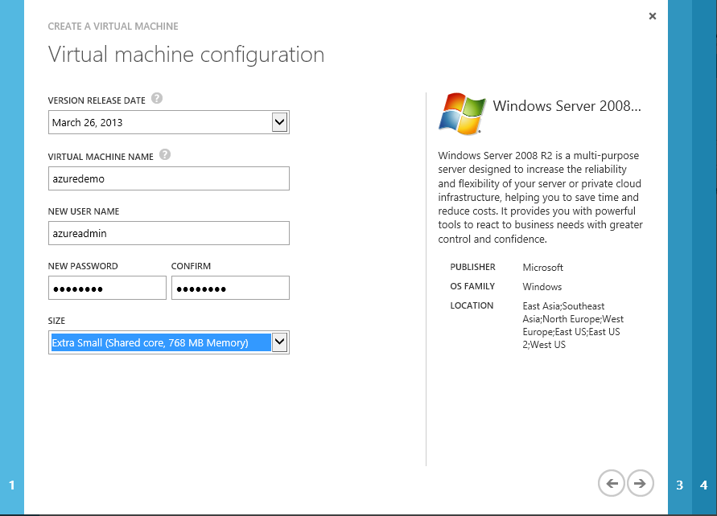
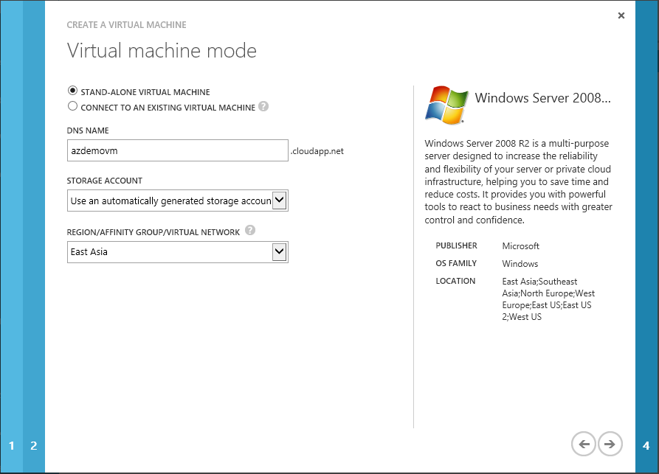
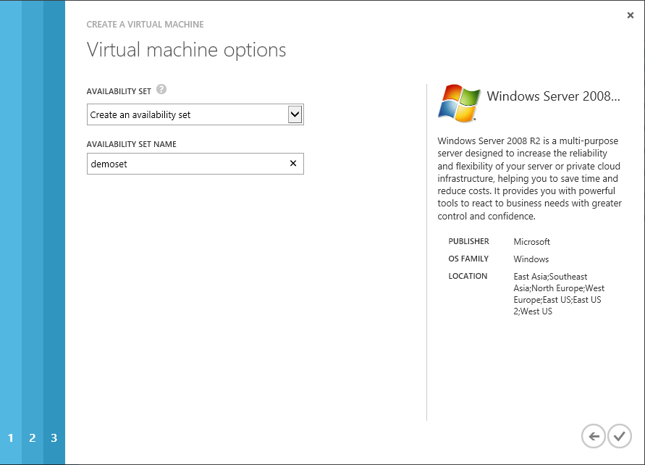
Create VM
2. Virtual Machine
Azure Management Portal is easy and fast way to Provision VM.
1. Select OS and Applications
2. Select VM Size
3. Select Datacenter
4. Extension
Step |  | Detail
1 | Select OS and Applications | Windows Azure에서 제공하는 가상 컴퓨터는 Windows 와 Linux가 있으며, 선택된 운영 체제에 대한 관리자 권한을 취득합니다.
2 | Select VM Size | 가상 컴퓨터에 설치된 운영체제의 계정과 비밀번호를 설정하고, 가상 컴퓨터의 CPU/Memory 사이즈를 선택 합니다.
3 | Select Datacenter | 가상 컴퓨터를 인터넷을 통해 접속할 수 있는 DNS 이름과 가상 컴퓨터가 운영될 데이터센터를 선택합니다.
4 | Extension | VM Agent 설치 및 Extension 설치에 대한 선택을 하고 가상 컴퓨터 생성을 시작 합니다.

Slide 6



Create VM on your need
2. Virtual Machine
Select from Image Gallery
Log in to
Windows Azure
Management Portal
Create new VM from image gallery
The image is copied to
your blob storage account
Virtual Machine booted. Changes direct-write to blob storage
Bring your own custom VHD
Create your own VHD
Upload image to blob storage
Create a Virtual Machine by attaching to disk
Virtual Machine booted. Changes direct-write to blob storage

Slide 7
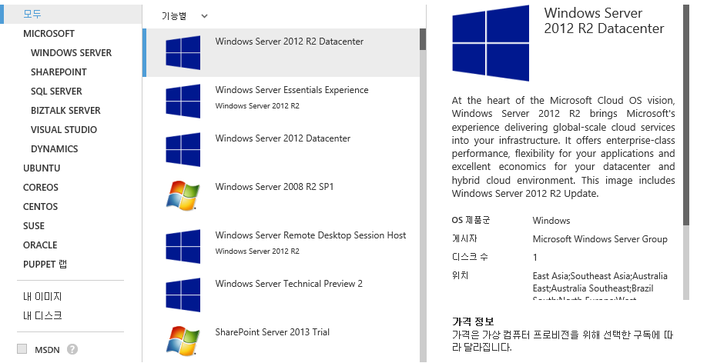
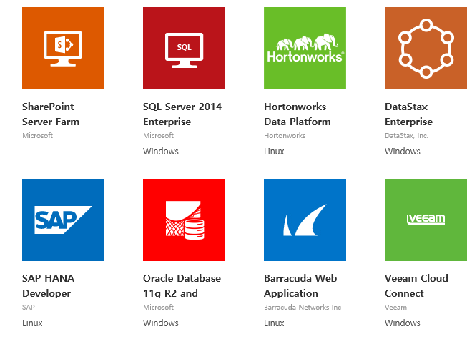
Images
2. Virtual Machine
Choose OS and Application on your need.

Slide 8
Working with Linux
2. Virtual Machine
Supported Distributions & Versions from Azure Image Gallery
Distribution | Version | Drivers | Agent
Canonical Ubuntu | Ubuntu 12.04, 14.04, 14.10 and 15.04 | In Kernel | Package: In repo under "walinuxagent" Source: GitHub
CentOS by OpenLogic | CentOS 6.3+, 7.0+ | CentOS 6.3: LIS Download CentOS 6.4+: In Kernel | Package: In OpenLogic repo under "WALinuxAgent" Source: GitHub
CoreOS | 494.4.0+ | In Kernel | Source: GitHub
Oracle Linux | 6.4+, 7.0+ | In Kernel | Package: In repo under "WALinuxAgent" Source: GitHub
SUSE Linux Enterprise | SLES 11 SP3+, SLES 12+ and SLES for SAP 11.3+ | In Kernel | Package: In Cloud:Tools repo under "WALinuxAgent" Source: GitHub
openSUSE | openSUSE 13.1+ | In Kernel | Package: In Cloud:Tools repo under "WALinuxAgent" Source Code: GitHub

Slide 9
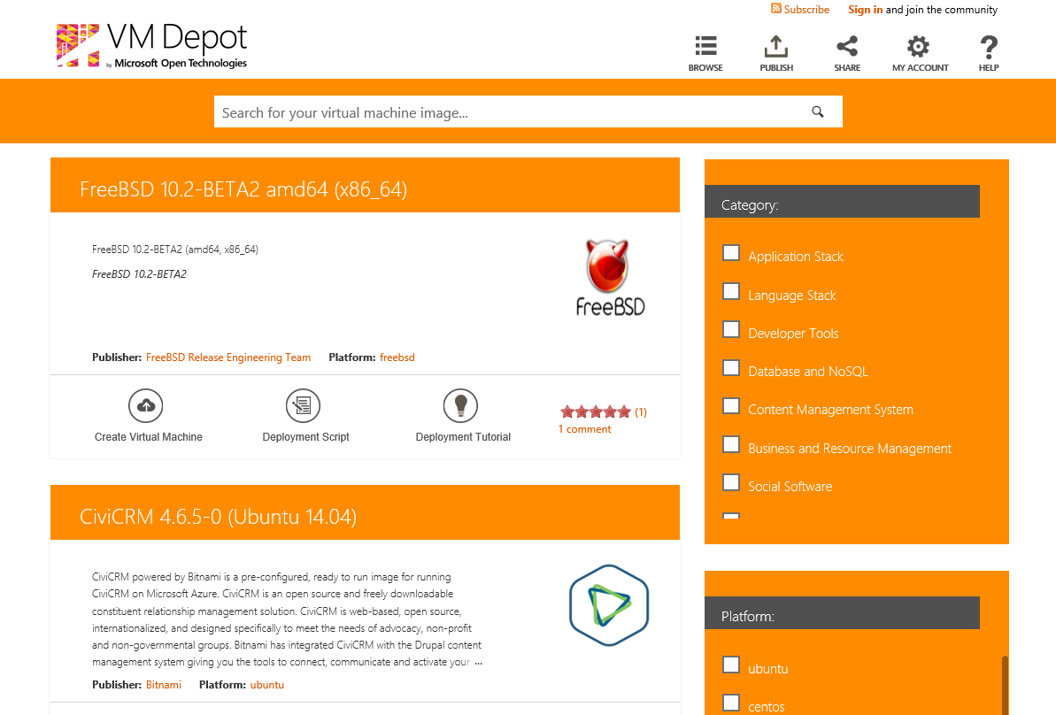
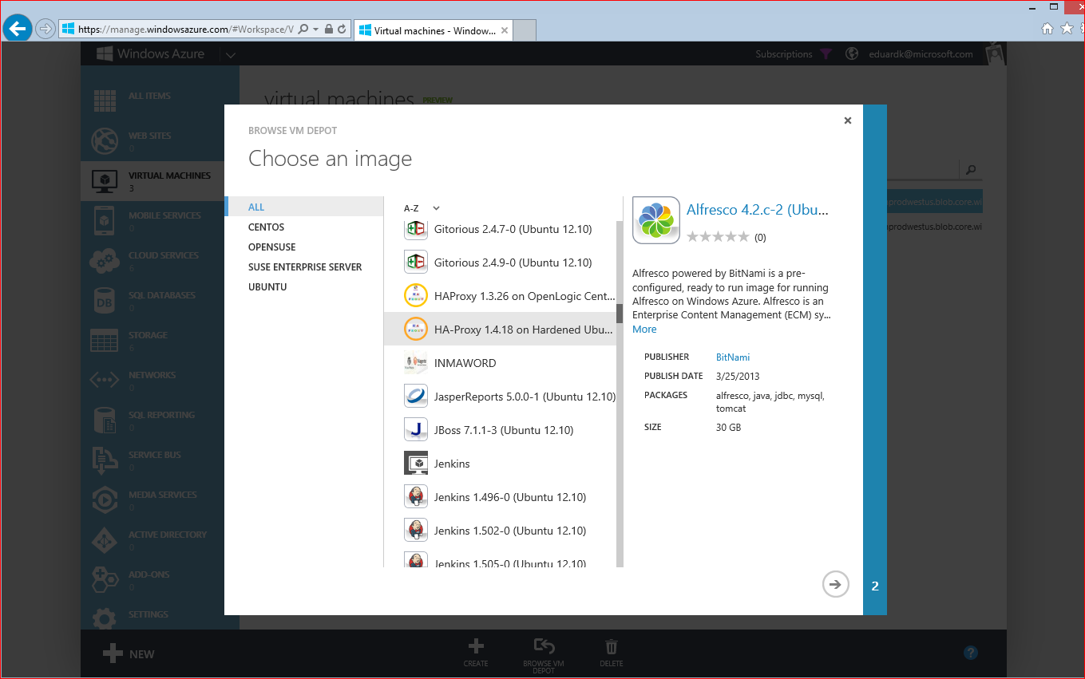
Working with Open Source Images
2. Virtual Machine
Provision Open Sources via VM Depot (https://vmdepot.msopentech.com)
Growing gallery of open source Linux images
Licensed & supported by the community
Integrated with Microsoft Azure Management Portal for easy deployment

Slide 10
Virtual Machine Size (1)
2. Virtual Machine
A Series – General purpose compute
VM Size |  | VM Tier | CPU Cores | Memory | #Data Disks | Maximum IOPS
General | A0 | Basic / Standard | Shared | 768 MB | 1 | 1 * 500 IOPS
 | A1 | Basic / Standard | 1 | 1.75 GB | 2 | 2 * 500 IOPS
 | A2 | Basic / Standard | 2 | 3.5 GB | 4 | 4 * 500 IOPS
 | A3 | Basic / Standard | 4 | 7 GB | 8 | 8* 500 IOPS
 | A4 | Basic / Standard | 8 | 14 GB | 16 | 16 * 500 IOPS
Memory Intensive | A5 | Standard | 2 | 14 GB | 4 | 4 * 500 IOPS
 | A6 | Standard | 4 | 26 GB | 8 | 8 * 500 IOPS
 | A7 | Standard | 8 | 56 GB | 16 | 16 * 500 IOPS
Compute Intensive | A8 | Standard | 8 (Intel) | 56 GB (RDMA) | 16 | 16 * 500 IOPS
 | A9 | Standard | 16 (Intel) | 112 GB (RDMA) | 16 | 16 * 500 IOPS

Slide 11
Virtual Machine Size (2)
2. Virtual Machine
D/DS Series – Optimized compute
VM Size |  | VM Tier | CPU Cores | Memory | Local SSD Size (ephemeral) | Local SSD Max Read (ephemeral) | Local SSD Max Write (ephemeral)
General | D1 | Basic / Standard | 1 | 3.5 GB | 50 GB | 48 MB/s | 24 MB/s
 | D2 | Basic / Standard | 2 | 7 GB | 100 GB | 96 MB/s | 48 MB/s
 | D3 | Basic / Standard | 4 | 14 GB | 200 GB | 192 MB/s | 96 MB/s
 | D4 | Basic / Standard | 8 | 28 GB | 400 GB | 384 MB/s | 192 MB/s
Memory Intensive | D11 | Basic / Standard | 2 | 14 GB | 100 GB | 96 MB/s | 48 MB/s
 | D12 | Basic / Standard | 4 | 28 GB | 200 GB | 192 MB/s | 96 MB/s
 | D13 | Basic / Standard | 8 | 56 GB | 400 GB | 384 MB/s | 192 MB/s
 | D14 | Standard | 16 | 112 GB | 800 GB | 678 MB/s | 384 MB/s

Slide 12
Virtual Machine Size (3)
2. Virtual Machine
G Series – Performance optimized compute
VM Size |  | VM Tier | CPU Cores | Memory | Local SSD Storage (GB) | #Data Disks
Performance optimized | G1 | Standard | 2 | 28 GB | 412 | 4
 | G2 | Standard | 4 | 56 GB | 824 | 8
 | G3 | Standard | 8 | 112 GB | 1649 | 16
 | G4 | Standard | 16 | 224 GB | 3298 | 32
 | G5 | Standard | 32 | 448 GB | 6596 | 64

Slide 13



Manage VM Network
2. Virtual Machine
Azure Virtual Machine includes capabilities to control network for Virtual Machines
Firewall configuration is done automatically for ports associated with Remote Desktop and Secure Shell (SSH), and in most cases for Windows PowerShell Remoting. For ports specified for all other endpoints, no configuration is done automatically to the firewall in the guest OS.
You can create access control lists (ACLs) to manage access to the VM endpoints.
You can configure endpoint monitoring (Preview) to monitor the availability of HTTP or HTTPS endpoints from geo-distributed locations.
Network Service Layer
Port Forwarding
Access Control
EndPoint
TCP 80
Microsoft Azure
Virtual Machine
Load Balancer
(L4)
EndPoint
TCP 80
Cloud Service
(Domain Name)
Virtual Machine
Users
EndPoint
TCP 80
EndPoint
TCP 8080
Virtual Machine

Slide 14
Manage VM Network > Endpoint (1)
2. Virtual Machine
Communication settings including the protocol, public port, and private port to handle different types of inbound network traffic to the VM
Port Forwarding
Public Port and Private Port should be mapped
Access VM can be distinguished by Public Port
Cloud Service | Endpoint Name | Protocol | Public Port | Private Port | VM | Load Balance Set
*.cloudapp.net | Remote Desktop (VM1) | TCP | 5586 | 3389 | VM1 | No
 | Remote Desktop (VM2) | TCP | 5587 | 3389 | VM2 | No
Cloud App / Hosted Service
PORT 5586
PORT 3389
VM1
LB/IP
PORT 5587
PORT 3389
VM2
Public Port
Private Port

Slide 15
Manage VM Network > Endpoint (2)
2. Virtual Machine
Communication settings including the protocol, public port, and private port to handle different types of inbound network traffic to the VM
Access Control
Public Port and Private Port should be mapped
Access VM can be distinguished by Public Port
Cloud Service | Rule Priority | Client IP Address (CIDR) | Allow / Deny | End Point Name
*.cloudapp.net | 100 | 65.0.0.0/8 | Allow | Remote Desktop
 | 200 | 159.0.0.0/8 | Allow | Remote Desktop
Cloud App / Hosted Service
65.0.0.0/8
O
PORT 5586
PORT 3389
LB/IP
VM1
77.0.0.0/8
X
Public Port
Private Port

Slide 16
Manage VM Network > Endpoint (3) - SLB (Software Load Balancer)
2. Virtual Machine
A configuration of endpoints on 2 or more VMs that randomly distribute a specified type of inbound network traffic across the VMs
Distribute load to two or more VMs
Provides L4 level of network load balance
Round-Robin distribution based on following rules:
5 tuple (source IP, source port, destination IP, destination port, Protocol type)
3 tuple (Source IP, Destination IP, Protocol)
2 tuple (Source IP, Destination IP)
Cloud Service | Endpoint Name | Protocol | Public Port | Private Port | VM | Load Balance Set
*.cloudapp.net | HTTP (80) | TCP | 80 | 80 | VM1 | YES
 |  |  |  |  | VM2
Cloud App / Hosted Service
PORT 80
VM1
PORT 80
LB/IP
PORT 80
VM2
Public Port
Private Port

Slide 17
Manage VM Network > Endpoint (3) - SLB (Software Load Balancer)
2. Virtual Machine
A configuration of endpoints on 2 or more VMs that randomly distribute a specified type of inbound network traffic across the VMs
LB에 대한 사용료가 없음
LB는 VMs 앞단에 거대한 클러스터로 구성되어 있음
Multi-Tenant 환경에 적합하도록 Software 기반의 LB 구성
마이크로소프트 데이터센터에서 직접 관리
클러스터는 VM과 상관없이 이미 구성되어 관리 됨
현재도 계속 최적화 작업을 진행 중
VMs의 전체 네트워크 대역 총합보다 배이상 큰 규모의 네트워크를 확보
VM이 요구하는 네트워크 성능 제공이 보장 되어 있음
VM의 사이즈에 따른 네트워크 대역폭은 보장되어 있음
제한
SSL termination 미지원
Cookie 기반의 Sticky Session 미지원
단, Tuple 기반의 Session 유지는 4분으로 관리되어 유지 됨
SLB의 제한은 Application Gateway Service 로 대응
Internet
Router
Router
Multiplexer
Multiplexer
VM
VM
VM
VM

Slide 18
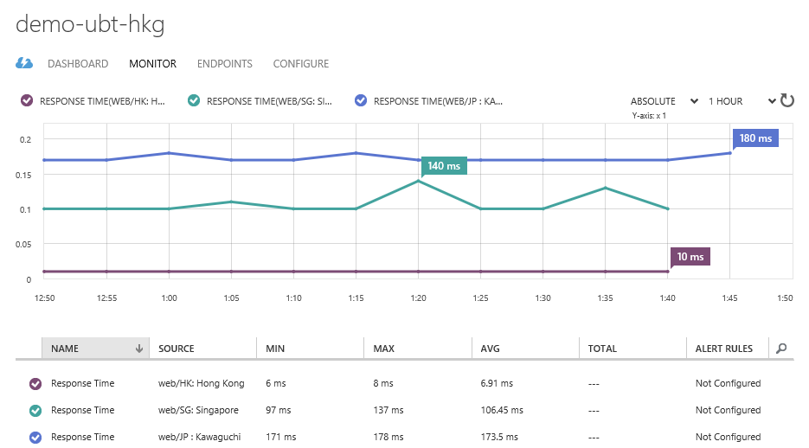
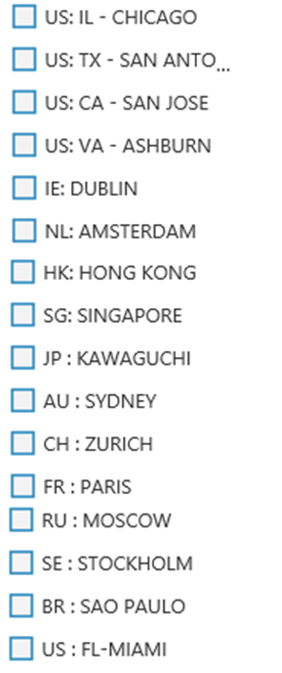
Manage VM Network > Endpoint (4) - Monitoring Service (PREVIEW)
2. Virtual Machine
You can configure endpoint monitoring (Preview) to monitor the availability of HTTP or HTTPS endpoints from geo-distributed locations
Endpoint monitoring lets you monitor the availability of HTTP or HTTPS endpoints from geo-distributed locations. You can test an endpoint from up to three geo-distributed locations. A monitoring test fails if the HTTP response code is greater than or equal to 400 or if the response takes more than 30 seconds. An endpoint is considered available if its monitoring tests succeed from all the specified locations.

Slide 19
3. Storage
Virtual Machine uses Azure Storage Page Blob to store data.
Azure Storage 기반 Disk 구성하여 VM에 OS 및 Data Disk로서 동작
VM
특징
Storage 서비스에 page blob 형태로 저장
VHD를 Disk로 등록 사용
Disk를 VM에 연결할 때 cache를 명시적으로 정의
데이터 쓰기: Blob 에 데이터 쓰기 완료 후 application commit 완료
데이터 읽기: cache 또는 Blob 데이터를 읽음
Application
Drive X:
OS
Local Cache
Microsoft Azure Blob
VHD

Slide 20




Microsoft Azure Storage Basic Concept
3. Storage
Persistent Virtual Machines Data with Local Redundant Storage.
Microsoft Azure Storage

Slide 21

Microsoft Azure Storage Basic Concept
3. Storage
Persistent Virtual Machines Data with Local Redundant Storage.
Microsoft Azure Storage

Slide 22
Microsoft Azure Storage Basic Concept
3. Storage
Persistent Virtual Machines Data with Geo Redundant Storage.
WEST
DC
EAST
DC
> hundreds of miles
continuous storage geo-replication
Microsoft Azure Storage
* Avoid use of striped disks with geo-replication

Slide 23
Virtual Machine Disk (Azure Storage Page Blobs & Disks types)
3. Storage
Optimized for random read and write operations, page blobs are ideal for VHD images.
Azure Storage Blob 저장소 사용
Data 보호를 위한 원본 데이터 포함 3벌의 데이터 저장
데이터 쓰기 작업 시 원본과 복제본은 오차 없이 동기화되어 저장
저장소의 디스크, 노드 또는 Rack의 장애로부터 안전하게 데이터 보호
실제 데이터를 저장하여 사용하는 저장소 공간에 대한 비용만 지불
옵션에 따라 최대 6벌까지 데이터 복제본 관리 가능
가상 디스크 (VHD – Virtual Hard Disk) 형식으로 데이터 저장
일반적으로 잘 알려진 형식으로 다양한 Hypervisor와 호환 가능
On-premise에 있는 VHD를 Azure에 upload하여 바로 사용 가능
사이즈 및 성능
디스크 당 최대 0.99 TB 지원
500 IOPS 수준의 성능 제공
단, Premium Storage 경우, 디스크당 최대 5000 Provisioned IOPS를 제공
Virtual Machine
C:\
OS Disk
D:\
Temporary Disk Dynamic VHD
E:\, F:\, etc.
Data Disks
RAM Cache
Local Disk Cache
Striped Volume
Blob
Blobs

Slide 24
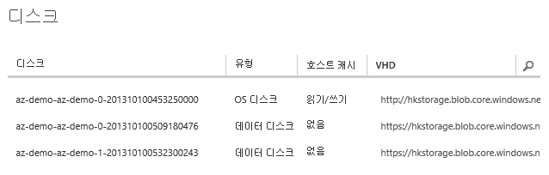
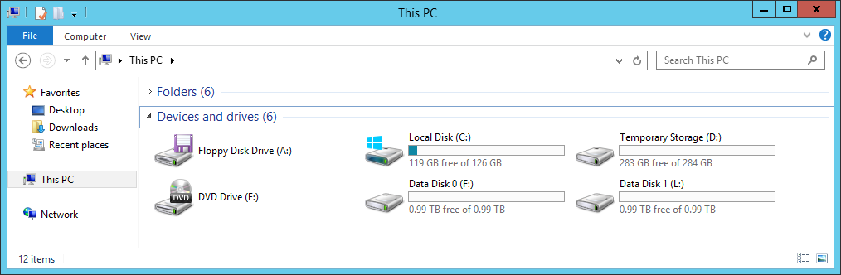
Virtual Machine Disk
3. Storage
가상 컴퓨터의 운영체제 및 데이터를 안정하게 저장하기 위한 디스크 (Disk)를 사용합니다.
가상 컴퓨터 Disk 종류와 특징
1. OS Disk (persistent)
운영체제를 포함하는 디스크
최대 사이즈: 127GB
호스트 캐시: 읽기/쓰기
데이터 손실 없음
VHD로서 Blob 저장소에 위치
읽기 작업에 대한 낮은 지연성
2. Data Disk (persistent)
데이터 저장을 위한 디스크
최대 사이즈: 1023 GB (0.99 TB)
호스트 캐시: 없음 (권장)
데이터 손실 없음
VHD로서 Blob 저장소에 위치
최대 성능: 500 IOPS / Disk
3. Temporary Local Disk (non-persistent)
VM OS의 성능 최적화, 페이징을 목적으로하는 임의 저장소
최대 사이즈: 605 GB
호스트 캐시: 적용 불가
재부팅 등으로 인한 데이터 손실 있음
호스트의 Disk에 일부 공간을 임의로 할당
저장소 Transaction 등 비용 무료
비교적 낮은 지연성
1. OS Disk
3. Temporary Local Disk
2. Data Disk

Slide 25
Virtual Machine Disk
3. Storage
Persistent Disk Management
C:\ = OS Disk
D:\ = Non-Persistent Cache Disk
E:\, F:\. G:\ ... Data Disks
Capability | OS Disk | Data Disk
Disk Cache Default | ReadWrite | None
Disk Cache Options | Read-only and ReadWrite | None, Read-only and ReadWrite
Max Capacity | 1023 GB | 1024 GB
Imaging Capable | Yes | Yes
Hot Update | Cache Setting Requires Reboot | Change Cache Without Reboot, Add/Remove without Reboot.

Slide 26
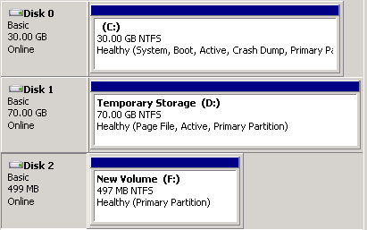
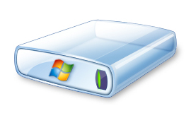
Virtual Machine Disk Mobility
3. Storage
Custom OS/Data Disk
On-premise
Windows Azure
Virtual Machine
1
Upload VHD
.VHD
3
Attach Disk
2
Create Disk
.VHD
Windows Azure Blob Storage

Slide 27
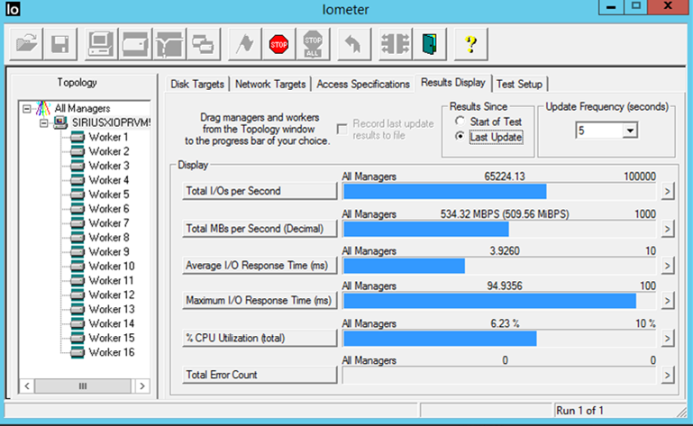
Premium Storage
3. Storage
Solid State Drive (SSD) based Storage designed to support I/O intensive workloads with significantly high throughput and low latency.
SSD 기반의 고성능 프리미엄 스토리지를 제공
SSD 기반 고성능 스토리지
SSD 기반의 예측 가능하고 높은 IO 처리가 가능
고성능 IO 집중적인 데이터베이스 워크로드 등에 적합
10 Milliseconds 이하의 대기시간(latency)
높은 스케일
최대 1 TB의 blob/disk 크기 지원
최대 32 디스크를 스트라이프하여 총 32 TB의 스토리지 가능하며, 50,000 IOPS 이상 지원
프리미엄 스토리지 디스크는 DS 시리즈와 함께 사용
* Premium Storage is only available in West US, East US 2, West Europe, Southeast Asia, Japan West and Australia East regions.

Slide 28
Premium Storage
3. Storage
Solid State Drive (SSD) based Storage designed to support I/O intensive workloads with significantly high throughput and low latency.
Premium Storage supports only Azure page blobs
Persistent disks for Azure Virtual Machines (VMs)
locally redundant (LRS) and keeps three copies of the data within a single region
To use a Premium Storage account for your VM disks, you need to use the DS-series of VMs.
You can use both Standard and Premium storage disks with DS-series of VMs.
But you cannot use Premium Storage disks with non-DS-series of VMs.
A premium storage account cannot be mapped to a custom domain name.
Storage analytics is not currently supported for Premium Storage.
To analyze the performance metrics of VMs using disks on Premium Storage accounts, use the operating system based tools
Windows Performance Monitor for Windows VMs
IOSTAT for Linux VMs.
* Premium Storage is only available in West US, East US 2, West Europe, Southeast Asia, Japan West and Australia East regions.

Slide 29
Premium Storage
3. Storage
Performances and Maximum Capacity
Performance
Consider both Virtual Machine Max. Disk Bandwidth and Premium Storage Throughput per disk
VM Size | CPU cores | Max. IOPS | Max. Disk Bandwidth
STANDARD_DS1 | 1 | 3,200 | 32 MB per second
STANDARD_DS2 | 2 | 6,400 | 64 MB per second
STANDARD_DS3 | 4 | 12,800 | 128 MB per second
STANDARD_DS4 | 8 | 25,600 | 256 MB per second
STANDARD_DS11 | 2 | 6,400 | 64 MB per second
STANDARD_DS12 | 4 | 12,800 | 128 MB per second
STANDARD_DS13 | 8 | 25,600 | 256 MB per second
STANDARD_DS14 | 16 | 50,000 | 512 MB per second
Premium Storage Disk Type | P10 | P20 | P30
Disk size | 128 GiB | 512 GiB | 1024 GiB (1 TB)
IOPS per disk | 500 | 2300 | 5000
Throughput per disk | 100 MB per second * | 150 MB per second * | 200 MB per second *
* Premium Storage is only available in West US, East US 2, West Europe, Southeast Asia, Japan West and Australia East regions.

Slide 30
Premium Storage
3. Storage
Performances and Maximum Capacity
Maximum Capacity per account
Total Account Capacity | Total Bandwidth for a Locally Redundant Storage Account
Disk capacity: 35 TB Snapshot capacity: 10 TB | Up to 50 gigabits per second for Inbound + Outbound
* Premium Storage is only available in West US, East US 2, West Europe, Southeast Asia, Japan West and Australia East regions.

Slide 31
Premium Storage for Linux
3. Storage
Solid State Drive (SSD) based Storage designed to support I/O intensive workloads with significantly high throughput and low latency.
For all Premium Storage disks with cache setting as either “ReadOnly” or “None”, you must disable “barriers” while mounting the file system in order to achieve the scalability targets for Premium Storage. You do not need barriers for this scenario because the writes to Premium Storage backed disks are durable for these cache settings. When the write request successfully completes, data has been written to the persistent store. Please use the following methods for disabling “barriers” depending on your file system:
If you use reiserFS, disable barriers using the mount option “barrier=none” (For enabling barriers, use “barrier=flush”)
If you use ext3/ext4, disable barriers using the mount option “barrier=0” (For enabling barriers, use “barrier=1”)
If you use XFS, disable barriers using the mount option “nobarrier” (For enabling barriers, use the option “barrier”)
For Premium Storage disks with cache setting “ReadWrite”, barriers should be enabled for durability of writes.
Linux Distributions that we validated with Premium Storage
Distribution | Version | Supported Kernel | Supported Image
Ubuntu | 12.04 | 3.2.0-75.110 | Ubuntu-12_04_5-LTS-amd64-server-20150119-en-us-30GB
 | 14.04 | 3.13.0-44.73 | Ubuntu-14_04_1-LTS-amd64-server-20150123-en-us-30GB
 | 14.10 | 3.16.0-29.39 | Ubuntu-14_10-amd64-server-20150202-en-us-30GB
 | 15.04 | 3.19.0-15 | Ubuntu-15_04-amd64-server-20150422-en-us-30GB
SUSE | SLES 12 | 3.12.36-38.1 | suse-sles-12-priority-v20150213 suse-sles-12-v20150213
CoreOS | 584.0.0 | 3.18.4 | CoreOS 584.0.0
CentOS | 6.5, 6.6, 7.0 |  | LIS 4.0 Required
 | 7.1 | 3.10.0-229.1.2.el7 | LIS 4.0 Recommended
Oracle | 6.4 |  | LIS 4.0 Required
 | 7.0 |  | Contact Support for details
* Premium Storage is only available in West US, East US 2, West Europe, Southeast Asia, Japan West and Australia East regions.
** 참고: https://azure.microsoft.com/en-us/documentation/articles/storage-premium-storage-preview-portal/

Slide 32
Files (File Share Service)
3. Storage
Share files between applications running in your virtual machines using familiar Windows APIs or file REST API
Azure File service exposes file shares using the standard SMB 2.1 protocol.
The files can also be accessed at the same time via a REST interface
Description | Azure Blobs | Azure Files
Durability Options | LRS, ZRS, GRS (and RA-GRS for higher availability) | LRS, GRS
Accessibility | REST APIs | SMB 2.1 (standard file system APIs) REST APIs
Connectivity | REST – Worldwide | SMB 2.1 - Within region REST – Worldwide
Endpoints | http://myaccount.blob.core.windows.net/mycontainer/myblob | \\myaccount.file.core.windows.net\myshare\myfile.txt http://myaccount.file.core.windows.net/myshare/myfile.txt
Directories | Flat namespace however prefix listing can simulate virtual directories | True directory objects
Case Sensitivity of Names | Case sensitive | Case insensitive, but case preserving
Capacity | Up to 500TB containers | 5TB file shares
Throughput | Up to 60 MB/s per blob | Up to 60 MB/s per share
Object size | Up to 1 TB/blob | Up to 1 TB/file
Billed capacity | Based on bytes written | Based on file size

Slide 33
Files (File Share Service)
3. Storage
Share files between applications running in your virtual machines using familiar Windows APIs or file REST API
Compare Disk and Azure Files
Description | Disk | Azure Files
Relationship with Azure VMs | Required for booting (OS Disk)
Scope | Exclusive/Isolated to a single VM | Shared access across multiple VMs
Snapshots and Copy | Yes | No
Configuration | Configured via portal/Management APIs and available at boot time | Connect after boot (via net use on windows)
Built-in authentication | Built-in authentication | Set up authentication on net use
Cleanup | Resources can be cleaned up with VM if needed | Manually via standard file APIs or REST APIs
Access via REST | Can only access as fixed formatted VHD (single blob) via REST. Files stored in VHD cannot be accessed via REST. | Individual files stored in share are accessible via REST
Max Size | 1TB Disk | 5TB File Share 1TB file within share
Max 8KB IOps | 500 IOps | 1000 IOps
Throughput | Up to 60 MB/s per Disk | Up to 60 MB/s per File Share
http://blogs.msdn.com/b/windowsazurestorage/archive/2014/05/12/introducing-microsoft-azure-file-service.aspx

Slide 34
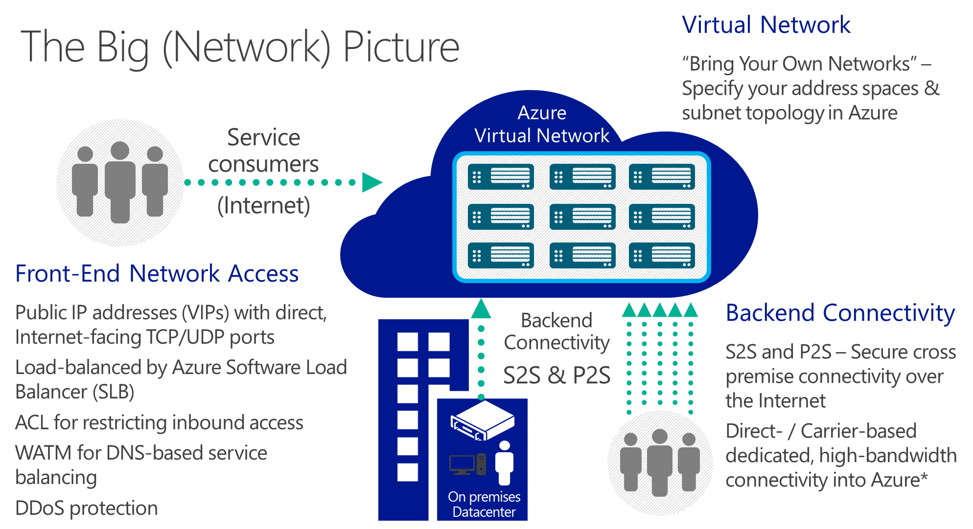
4. Network
다양한 서비스 요건을 만족하기위한 네트워크 서비스를 제공됩니다.

Slide 35

IP Address Concept
4. Network
VM은 유연한 서비스 시나리오 지원과 관리를 위한 다양한 IP 주소가 할당 됩니다.
VIP (= Public IP Address)
인터넷을 통해 접속할 수 있는 공인 IP 주소, Cloud Service에 할당되는 주소
VIP Reservation을 통해 예약(고정) 가능하며 5개 VIP를 예약 무료
ILIP (= Instance Level Public IP Address)
인터넷을 통해 접속할 수 있는 공인 IP 주소, VM에 할당되는 주소
PIP에 Domain Name 할당 가능
현재 예약(고정) 미지원
DIP (= Private IP Address)
인터넷을 통한 접근 않됨
Virtual Network 를 사용하는 경우, 고정 IP 사용이 가능함
Virtual Network 를 사용하지 안는 경우, 고정 IP 사용 불가능
VIP
ILIP
ILIP
*.cloudapp.net
…….
DIP
DIP
DIP
DIP

Slide 36
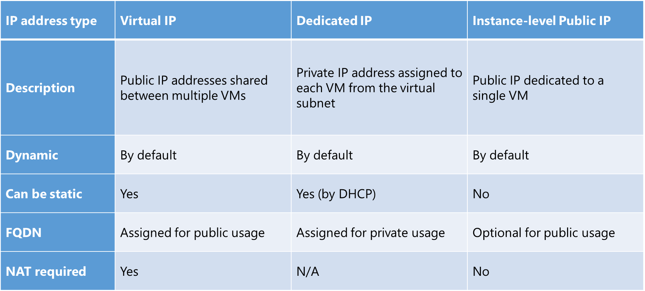
IP Address Concept
4. Network
VM은 유연한 서비스 시나리오 지원과 관리를 위한 다양한 IP 주소가 할당 됩니다.

Slide 37
Virtual Network
4. Network
Azure 데이터센터 내에 논리적인 가상의 네트워크 공간을 생성하고 사설 네트워크 환경을 구성 할 수 있습니다.
가상 사설 네트워크 (Private Network)
클라우드 데이터 센터 내부에 논리적으로 구분된 가상 네트워크 구성 (DIP와 유사)
IPv4 기반 가상 네트워크는 DHCP 자동 구성되어, IP 주소를 별도로 관리 불필요, 따라서, 가상 컴퓨터의 IP 주소를 Static 으로 변경은 미지원
각 서브넷의 첫 번째 및 마지막 IP 주소는 프로토콜 적합성을 위해 예약되어 사용 불가
VM에 IP 주소를 지정하지 않는 경우 (Static IP 미지정 시), DHCP에서 IP는 순차적으로 자동 할당
가상 컴퓨터간의 통신을 위한 논리적 네트워크 구성
가상 네트워크 상의 가상 컴퓨터 간 통신은 사설 IP 주소로 가능 (외부 인터넷을 통과하지 않음)
다중 subnet을 구성하여 서비스 자원들의 구분
Security Group 설정 (Subnet 간의 접근 통제 지원 )
가상 사설 네트워크상에 DMZ 구역을 설정하여 가상 컴퓨터를 외부로부터 보호할 수 있는 구성이 가능
Outbound 통신
가상 네트워크에 가입되어 있는 가상 컴퓨터는 별도 Gateway없이 Cloud Service IP (VIP)로 Outbound 통신 가능
Security Group 규칙에 따라 Outbound 통신 차단 가능
Azure DHCP
모든 Azure 상의 VM은 DHCP 구성으로 NIC가 설정 됨
VM내에서 static으로 구성할 경우, 네트워크 연결이 손실될 수 있음
DHCP 기능을 실행하는 VM을 실행할 수 없음

Slide 38
Virtual Network
4. Network
Azure 데이터센터 내에 논리적인 가상의 네트워크 공간을 생성하고 사설 네트워크 환경을 구성 할 수 있습니다.
Azure DNS
Azure가 제공하는 DNS를 사용하거나 별도의 DNS를 사용할 수 있음
최대 12개의 DNS를 설정할 수 있음(DNS는 순서대로 사용됨, no round-robin)
DNS 설정을 바꾸면 VM이 재시작되어야 DNS설정이 업데이트 됨
자체 Azure DNS의 기능
추가 구성 작업 없음
동일 Virtual Network내에 동일 Cloud Service간의 Name Resolution 지원
동일 Virtual Network내에 다른 Cloud Service간의 FQDN으로 Name Resolution 지원
호스트 이름 변경 지원
동일 VM에 복수개의 호스트이름 미지원
Azure에서 자동으로 생성한 DNS suffix 변경 미지원
임의 레코드 생성 불가
최대 100개 Cloud Service 지원

Slide 39
Virtual Network > Security Group
4. Network
Control traffic to one or more virtual machine (VM) instances in your virtual network
Control network traffic based on rules
Default Rules
Inbound
Outbound
Name | Priority | Source IP | Source Port | Destination IP | Destination Port | Protocol | Access
ALLOW VNET INBOUND | 65000 | VIRTUAL_NETWORK | * | VIRTUAL_NETWORK | * | * | ALLOW
ALLOW AZURE LOAD BALANCER INBOUND | 65001 | AZURE_LOADBALANCER | * | * | * | * | ALLOW
DENY ALL INBOUND | 65500 | * | * | * | * | * | DENY
Name | Priority | Source IP | Source Port | Destination IP | Destination Port | Protocol | Access
ALLOW VNET OUTBOUND | 65000 | VIRTUAL_NETWORK | * | VIRTUAL_NETWORK | * | * | ALLOW
ALLOW INTERNET OUTBOUND | 65001 | * | * | INTERNET | * | * | ALLOW
DENY ALL OUTBOUND | 65500 | * | * | * | * | * | DENY

Slide 40
Virtual Network > IP Address
4. Network
Azure 데이터센터 내에 논리적인 가상의 네트워크 공간을 생성하고 사설 네트워크 환경을 구성 할 수 있습니다.
생성
가상 네트워크 관리를 위한 이름과 주소 대역을 설정하여 생성
사설망 주소 지원 대역
10.0.0.0 ~ 10.0.255.255
172.16.0.0 ~ 172.16.255.255
192.168.0.0 ~ 192.168.255.255
각 대역별 최대 65536 개의 IP 주소 할당 가능
네트워크 구성 시 Affinity Group 사용
가상 네트워크에 가상 컴퓨터를 추가하는 경우 동일한 Affinity Group으로 지정해야 합니다.
구성 관리
Windows Azure 포털을 통한 직관적인 가상 네트워크 관리
이미 설정된 가상 네트워크에 새로운 Subnet (네트워크 대역)추가가 가능합니다.
DNS 서버와 서버의 IP 주소 관리를 위한 메뉴를 제공합니다.
가상 네트워크 상의 가상 컴퓨터 및 해당 IP에 정보 확인
가상 네트워크 구성 정보를 XML 형태로 내보내기 또는 불러오기하여 구성 가능
공용 IP 주소 범위 및 RFC1918에 정의된 IP 주소 범위를 사용 가능 함
Regional Network 로 확대되면서 Affinity Group 더 이상 불필요 함

Slide 41



Virtual Network
4. Network
Azure 데이터센터 내에 논리적인 가상의 네트워크 공간을 생성하고 사설 네트워크 환경을 구성 할 수 있습니다.
가상 네트워크에 구성(할당)이 가능한 Azure 서비스
가상 컴퓨터, 클라우드 서비스 그리고 웹 사이트
(Cross Region/Datacenter) 가상 네트워크 간의 연결 지원
Cloud Service
Virtual Machine
Web App
Vnet 1
Cloud Service
Virtual Machine
Vnet 2

Slide 42
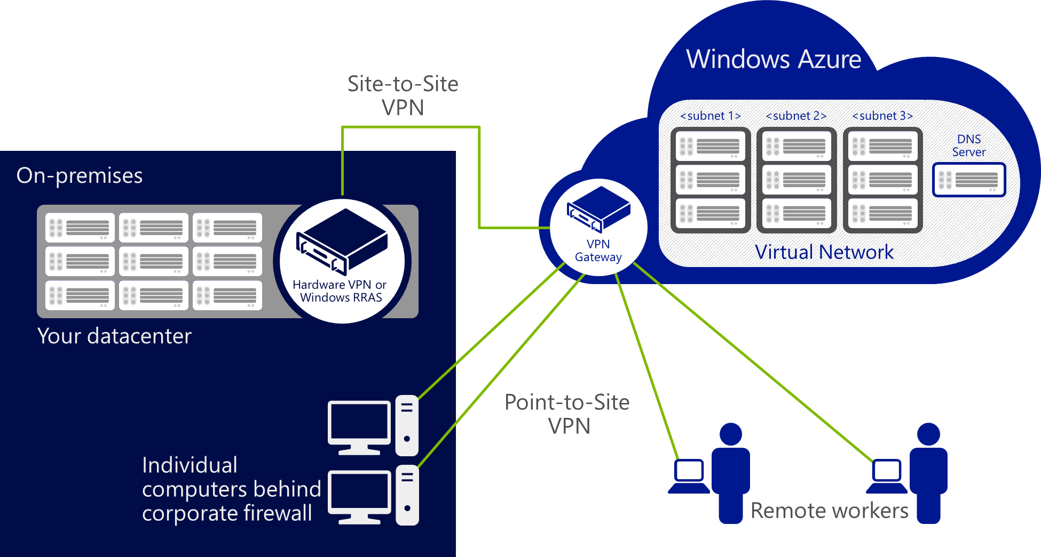
Virtual Network > Point-to-Site VPN
4. Network
Point-to-Site VPN을 지원하여 클라이언트를 가상 네트워크에 가입(Join) 시킬 수 있습니다.
Windows Azure에 논리적으로 구성된 가상 네트워크를 클라이언트로 접속하여 서비스 활용
VPN 클라이언트와 관련 인증서를 배포한 데스크탑 및 서버에서 Windows Azure 가상 네트워크의 자원으로 접속
다중의 클라이언트들이 Windows Azure에 구성된 가상 네트워크에 접속하여 통신 가능
TCP/UDP/ICMP 등 다양한 프로토콜 지원
단, UDP Multicast는 미지원
클라이언트 장치는 사용자가 정의한 범위 내에서 자동으로 IP를 할당 받음

Slide 43
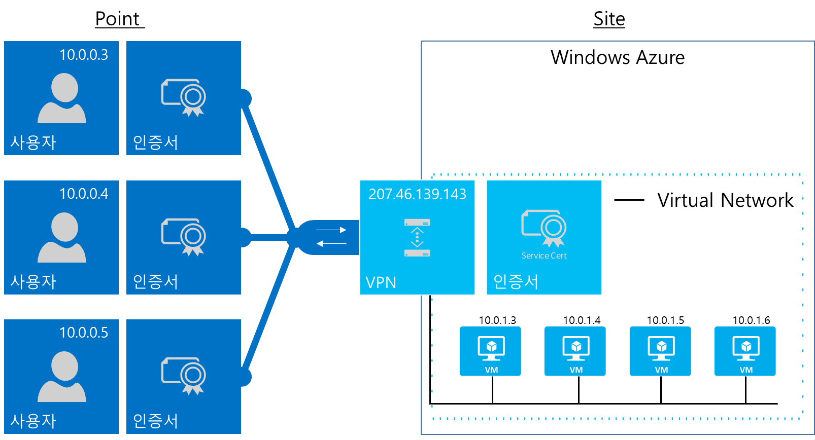
Virtual Network > Point-to-Site VPN
4. Network
가상 네트워크
Windows Azure에 논리적으로 구성되는 가상의 사설망
가상 네트워크 게이트웨이
Dynamic routing gateway
인증서
인증서 (X.509 certificate) 기반으로 Point-to-Site VPN 접속 인증
Root 인증서는 생성 후 Windows Azure Portal을 통해 Azure에 저장
가상 네트워크에 접속이 필요한 모든 장치에 Client 인증서와 클라이언트 배포
하나의 가상 네트워크에 대해 다중의 인증서가 배포 될 수 있음
VPN 클라이언트
Root 인증서를 Windows Azure Portal에 등록하면 VPN 클라이언트 다운로드 링크가 활성화 됨
가상 네트워크 접속을 위한 정보가 자동으로 포함되어 어플리케이션이 생성 됨
32bit/64bit 를 위한 별도의 패키지가 생성되며 운영체제 요건에 따라 다운로드하여 설치
지원 Client 운영 체제
Windows 7 (32-bit and 64-bit)
Windows Server 2008 R2 (64-bit only)
Windows 8 (32-bit and 64-bit)
Windows Server 2012 (64-bit only)

Slide 44
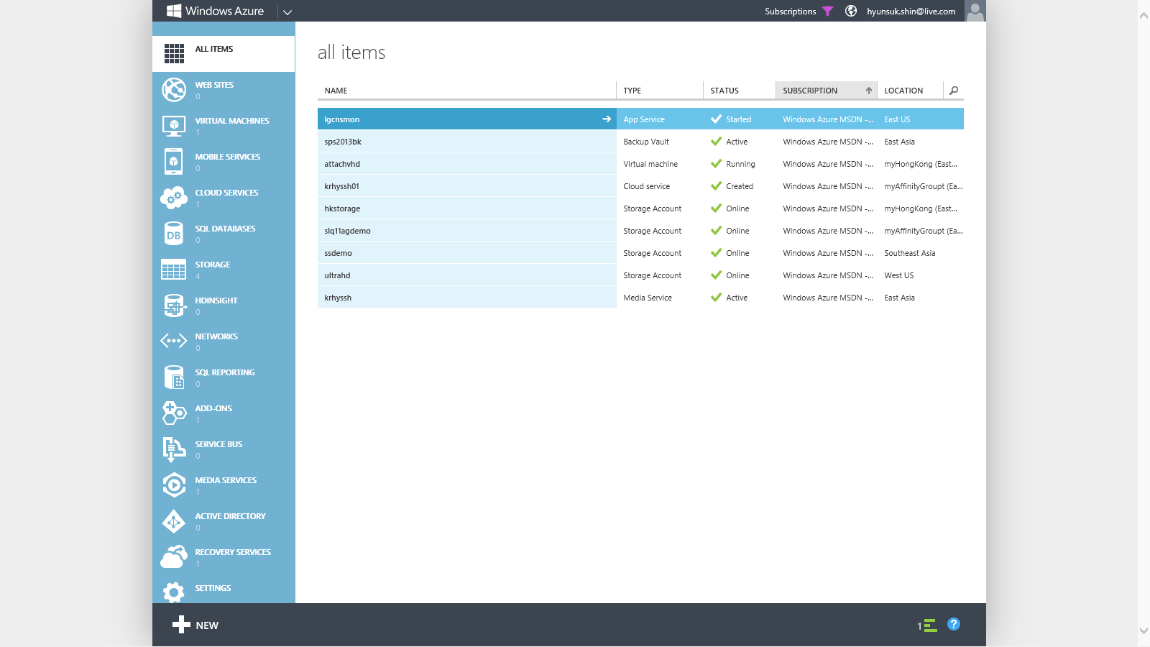
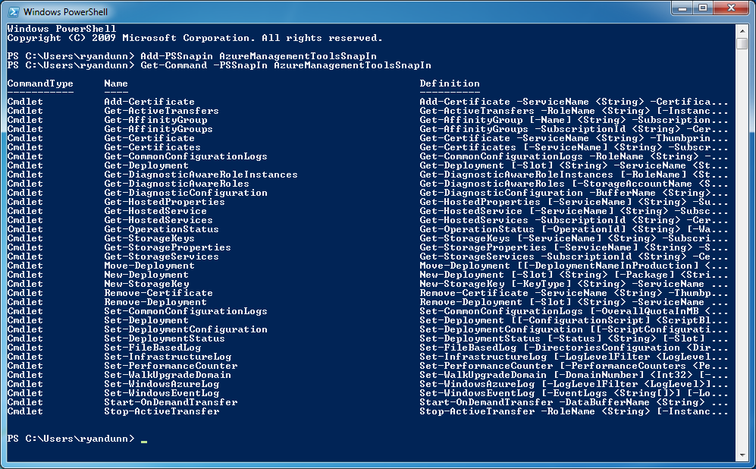

5. Manage VMs
Azure Management Portal에서 VM 관리를 위한 대시보드 및 서비스를 제공합니다.
다양한 관리 방안 제공
Windows Azure Management Portal
PowerShell
일반 사용자를 위한 직관적인 인터페이스와 다국어 (한글, 영어, 중국어, 일본어, 등 11개 언어) 를 지원 합니다.
전체 메뉴에서 세부적인 서비스 별 메뉴까지 터치 또는 마우스 클릭으로 관리 할 수 있는 환경을 제공합니다.
HTML 5 기반으로 PC 뿐만 아니라 Mobile 및 Device에서 서비스 관리 및 모니터링이 가능합니다.
기본 적인 신규 서비스 생성과 삭제 뿐만 아니라, 서비스와 관련된 데이터, BLOB 등 세부적인 내용 확인이 가능합니다.
전문가를 위한 Script 기반의 관리 환경을 제공합니다.
PowerShell을 통해서 모든 Azure의 서버스 구성이 가능합니다.
서비스 생성과 삭제뿐만 아니라 한 번에 여러 가상 컴퓨터나 관련 서비스를 주기적으로 실행할 때 용이합니다.
자주 사용하는 명령에 대해서는 사전에 Script를 생성해 두고 사용 할 수 있는 높은 재사용성을 제공합니다.

Slide 45
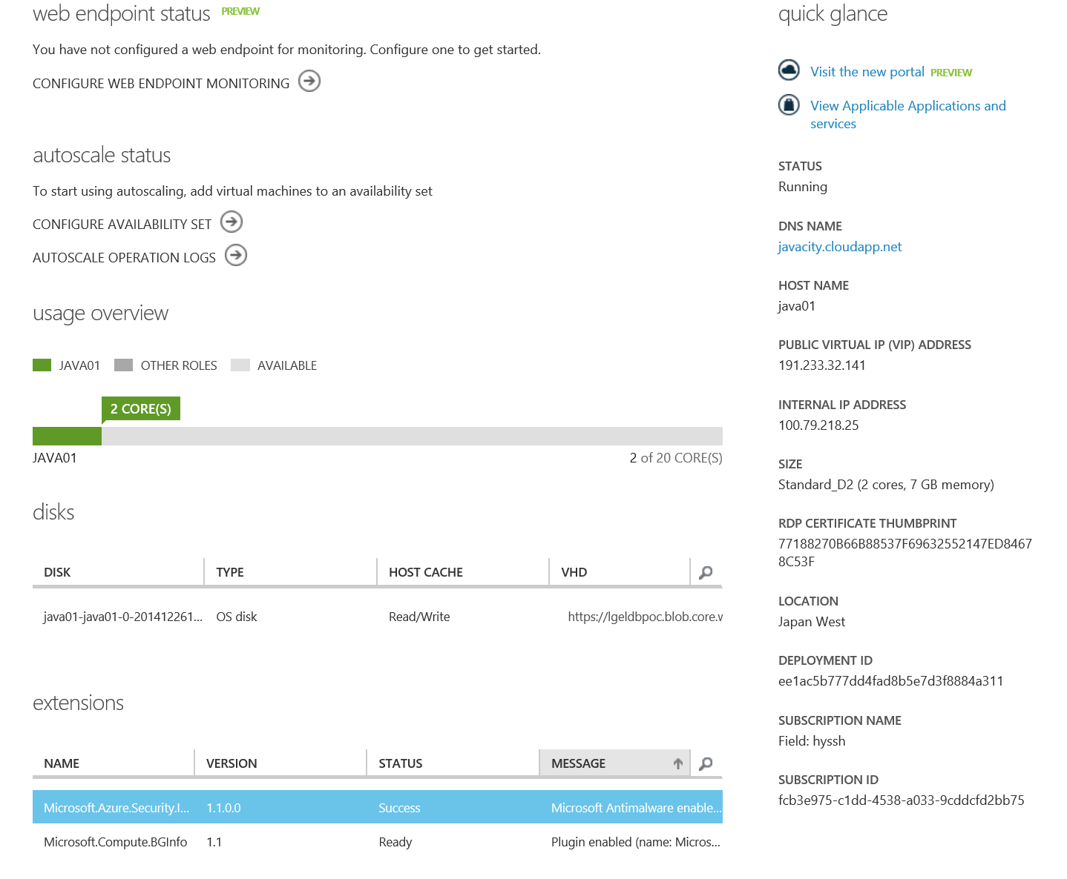
Virtual Machine Dashboard
5. Manage VMs
Virtual Machine Dashboard
Subscription
Cloud Service
Public Virtual IP
Virtual Machine
Storage Account
Deployment ID
VHD
Host Name
VHD
Size
VHD
Network
.
.
.
Internal IP
VHD

Slide 46
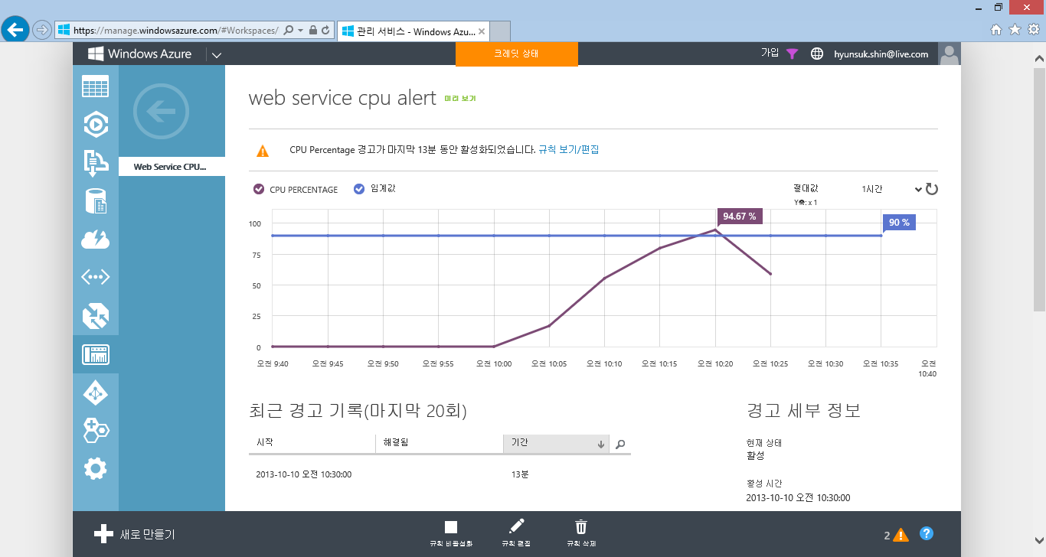
Virtual Machine Dashboard
5. Manage VMs
Azure 관리자 포털을 이용하여 가상 컴퓨터 상태에 대한 모니터링을 수행 할 수 있습니다.
15 ~ 20 분

Slide 47
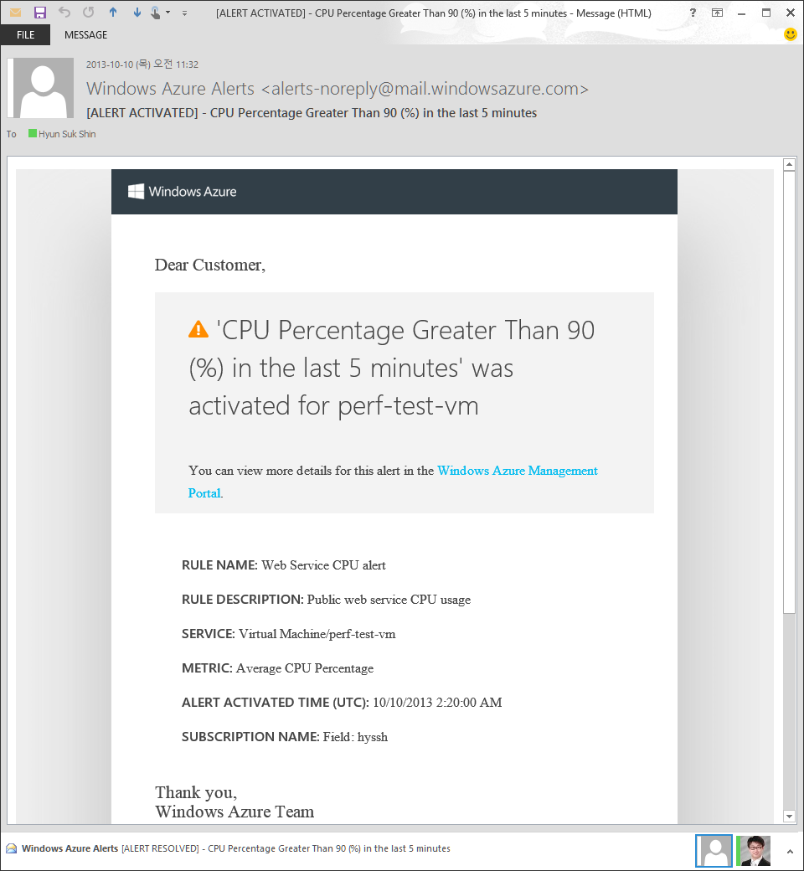
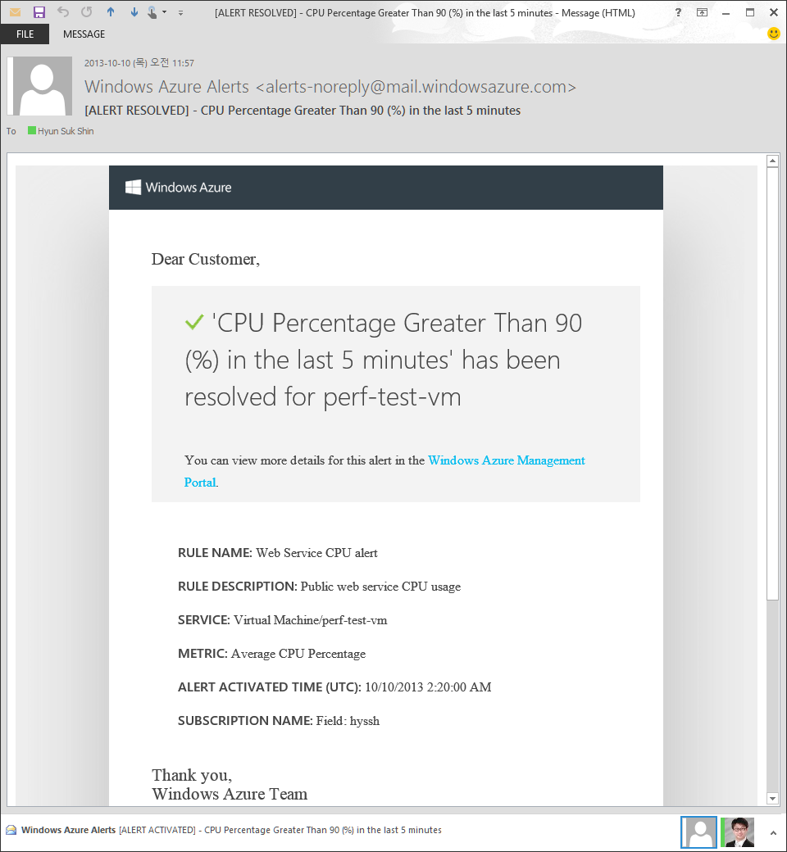
Alert
5. Manage VMs
특정 관리 항목을 지정하여 임계값을 설정하고 임계값 이상의 상황이 발생하는 경우 이를 Email을 발송하여 알려드립니다.
상태에 대한 경고 및 경고 해지 메일
CPU, Disk 그리고 네트워크 사용량에 대한 경고 및 알림 서비스
경고는 정의된 항복의 평균 값의 변화에 따라 발생하며 경고와 경고 해지 메일 각 1회 발송 됨
Azure 관리자외 추가 1명의 email을 추가 할 수 있음
고려 사항
모니터링 기준 5분 ~ 60분 평균 / 합계
CPU, Disk Read/Write 평균
Network IN/OUT 합계
Mail 발송 소요 시간 고려 (1~2분)
Event 시간 + 10분
CPU
임계값
0 분
5 분
10 분
15 분
경고 메일 발송
[ 경고 및 해결 안내 ]

Slide 48
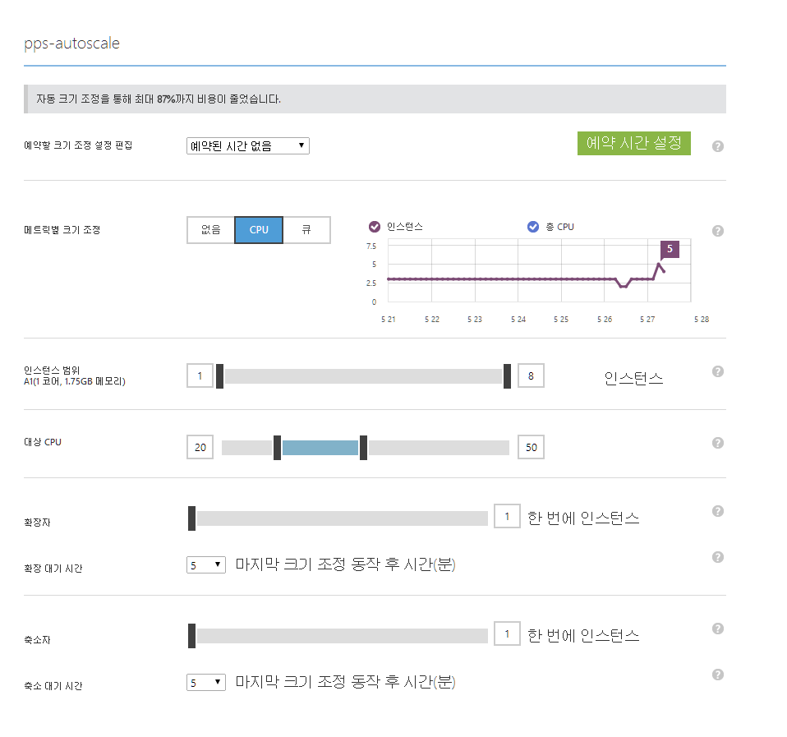
Autoscaling
5. Manage VMs
미리 가상 컴퓨터를 생성하고 CPU 평균 사용량에 따라 가상 컴퓨터 인스턴스 수를 자동으로 증감 시킬 수 있습니다.
가용 그룹 가상 컴퓨터 대상, 매 1분 마다 CPU 평균 사용률 계산 Auto-Scale 적용
지난 10분간의 CPU 평균 사용율
20% 미만인 경우
임의의 1개 가상 컴퓨터를 종료
20% 이상 그리고 50%이하 인 경우
별도의 Auto Scale 작업 없음
50% 초과인 경우
임의의 1개 가상 컴퓨터를 시작
Auto-Sacle 동작 후 대기시간 설정(Cool time)
10분간 추가적인 Auto-Scale 동작 없음

Slide 49
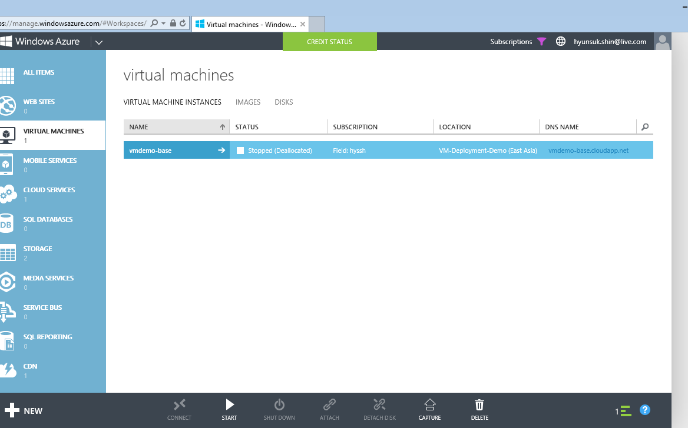
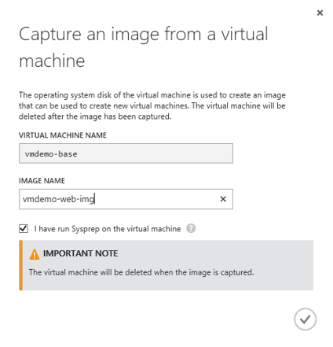
VM – Custom VM Image
5. Manage VMs
Three options in creating your own VM from your customized
Image
can capture a VM you configured on Azure
VHD is copied when a VM is created
can contain multiple VHDs
Generalized or specialized
Disk
Creating a VM from export and import a VM configuration
VHD is not copied
Uploading
You can upload your VHD you configured on a local Hyper-V
https://azure.microsoft.com/ko-kr/documentation/articles/virtual-machines-linux-create-upload-vhd-ubuntu/
VM Capture

Slide 50
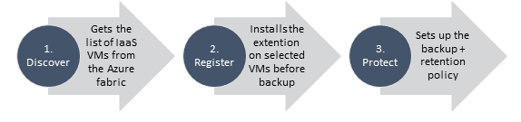
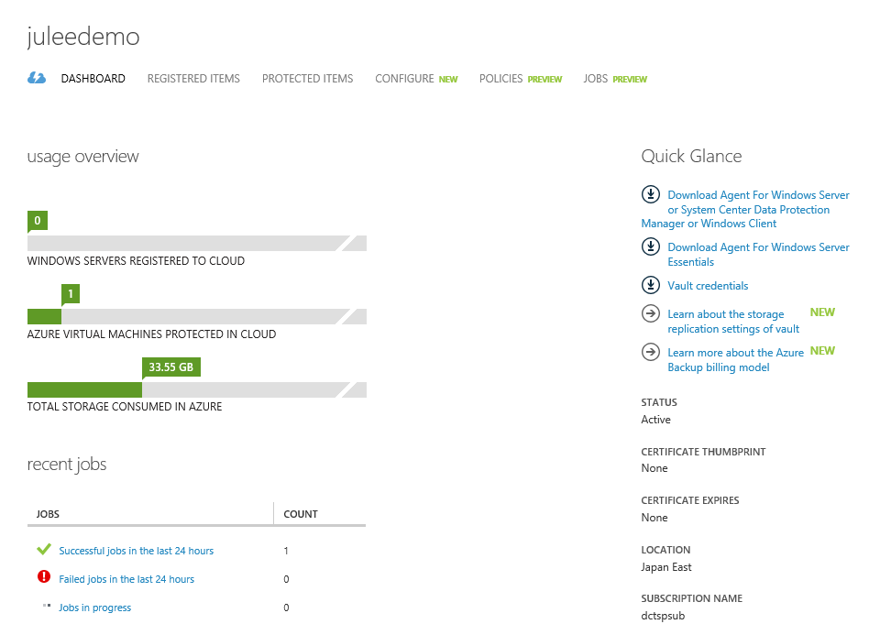
VM – Backup
5. Manage VMs
Azure VM can be backed up and recovered at any point you want
Application-consistent backup of virtual machines
No shut down of VM required
Application level consistency for Windows OSes
File system level consistency for Linux OSes
Fabric level backup
Agentless backup of multiple VMs at the same time
Single, central management interface through the Azure portal
Detailed Jobs view for tracking progress and success/failure
Policy-driven backup and retention
Configuration of scheduled backup
On-demand backup
Retain backup data in Azure Backup vault even if the original VM is deleted
Backup frequency: daily, weekly or manual (for preview)
Retention range: 4 weeks max (for preview)
Storage
Locally or geo redundant

Slide 51
Hand on Lab
Scenario #1. Deploy Service
http://azuretech.trafficmanager.net/Home/lab01

Slide 52
Hand on Lab
Scenario #2. Manage VMs
http://azuretech.trafficmanager.net/Home/lab02

Slide 53
Hand on Lab
Scenario #3. Create Premium Storage
http://azuretech.trafficmanager.net/Home/lab04

Slide 54
6. ARM (Azure Resource Manager)
Manage Azure Infrastructure More Easy
Resource Groups
Containers of multiple resource instances
Each resource instance has a resource type
Resource types are defined by resource providers
Every resource must exist in one and only one resource group
Management Container
Lifecycle: deployment, update, delete, status
Grouping: metering, billing, quota, UX (portal, PowerShell, CLI)
Access Control: scope for RBAC permissions
Identity: resources can talk to each other
Templates
Declarative, model based specification of resources and their configuration, code, and extensions
Idempotent
Consistent deployment
Source file, checked-in
Parameterized input/output
RESOU
R
CE G
R
OUP

Slide 56
Resources

